Slide 1
Chapter 4
Shell Scripting

Slide 2
At the end of this lesson, students will be able to:
Explain the fundamentals of shell scripting
Describe basic scripting concepts and their applications.
Write and execute simple shell scripts effectively.
Apply practical scripting techniques in various scenarios,

Slide 3
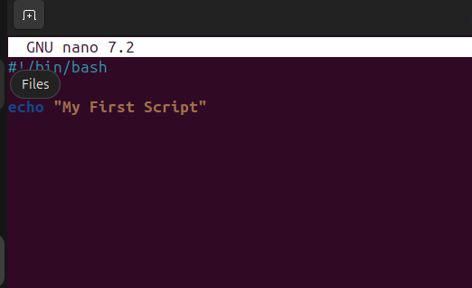
What is Shell Script?
-a shell script is a simply a file that contains a list of commands. It’s like a to-do list for your computer! Instead of typing each command individual, you can write them all in single file.

Slide 4
Basic Scripting Concepts
Shebang (#!/bin/bash): this is the line that start #! (called a shebang). It tells the system to use the bash shell to interpret the script and /bin/bash is the path to bash. So, when the scripts run, it knows exactly which shell to use
Comments (#): Add notes in your code.
Variables: name="Jerico"
Echo: Output something → echo "Hello, $name"

Slide 5
The two most common shells are:
Bash (Bourne Again Shell) – Default on most Linux systems.
zsh (Z Shell) – Popular for its customization, used by default in macOS.

Slide 6
Writing Your First Script
Create file
nano greet.sh
#!/bin/bash
echo "Hello! Welcome to scripting.“
Press CTRL+X to exit.
Press CTRL+Y to save.
the enter
How to run it:
bash greet.sh or
make executable the greet.sh:
chmod +x greet.sh
./greet.sh

Slide 7
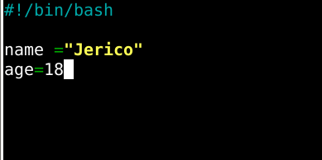
Basic Shell Scripting (Variables)

Slide 8
Environment Variables
-these are variables that stick around for the system or across scripts.
echo "Home Directory: $HOME"
echo "Username: $USER"
echo "Current Shell: $SHELL"
echo "Present Working Directory: $PWD"
echo "Random Number: $RANDOM"
echo "Seconds since script started: $SECONDS"

Slide 9
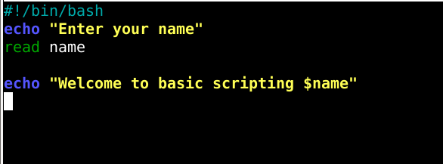
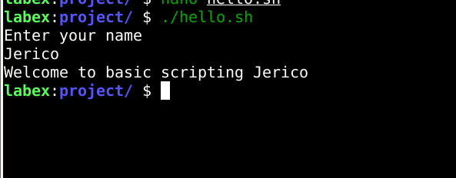
Basic Shell Scripting (Output and Input)

Slide 10
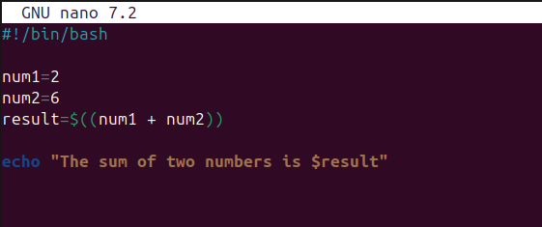
Basic Shell Scripting (Arithmetic and Mathematical Operators)
-bash scripting doesn’t do direct math, so you need $((expression)) to handle calculations.

Slide 11
Basic Shell Scripting (Comparison Operators)
Operator | Meaning | Example
-eq | Equal to | [ 5 -eq 5 ]
-ne | Not equal to | [ 5 -ne 3 ]
-gt | Greater than | [ 6 -gt 5 ]
-lt | Less than | [ 4 -lt 5 ]
-ge | Greater than or equal to | [ 5 -ge 5 ]
-le | Less than or equal to | [ 4 -le 5 ]

Slide 12
Basic Shell Scripting (Logical Operators)
Operator | Meaning | Example
&& | AND (both must be true) | if [ $age -ge 18 ] && [ $filipinocitizen = “yes" ]
|| | OR (atleast one is true ) | if [ $age -ge 18 ] || [ "$permit" = "yes" ]
! | NOT (negates condition) | if [ ! -f file.txt ] → true if file doesn't exist

Slide 13
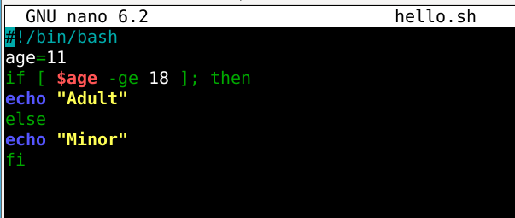

Basic Shell Scripting (if else Statement)

Slide 14
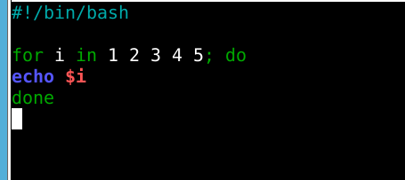
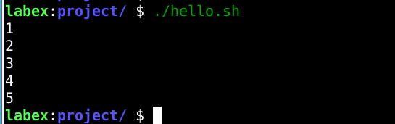
Basic Shell Scripting (Loops)
-For loop

Slide 15
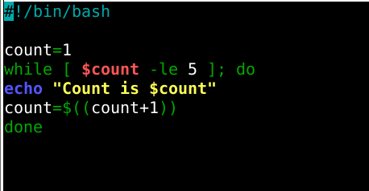
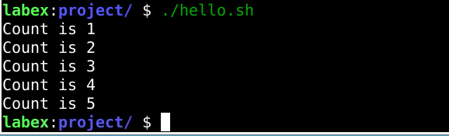
Basic Shell Scripting (Loops)
-while loop

Slide 16
Basic Shell Scripting (Loops)
-while loop

Slide 17
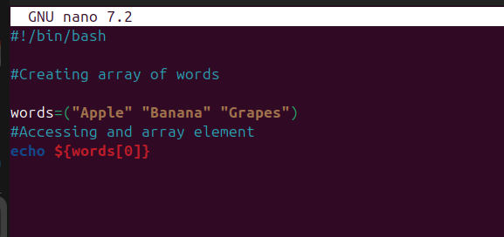
Basic Shell Scripting (Arrays)

Slide 18
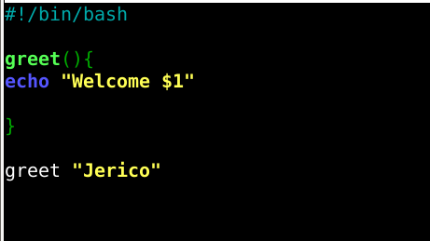

Basic Shell Scripting (Function)

Slide 19
Thank You

